Slide 1
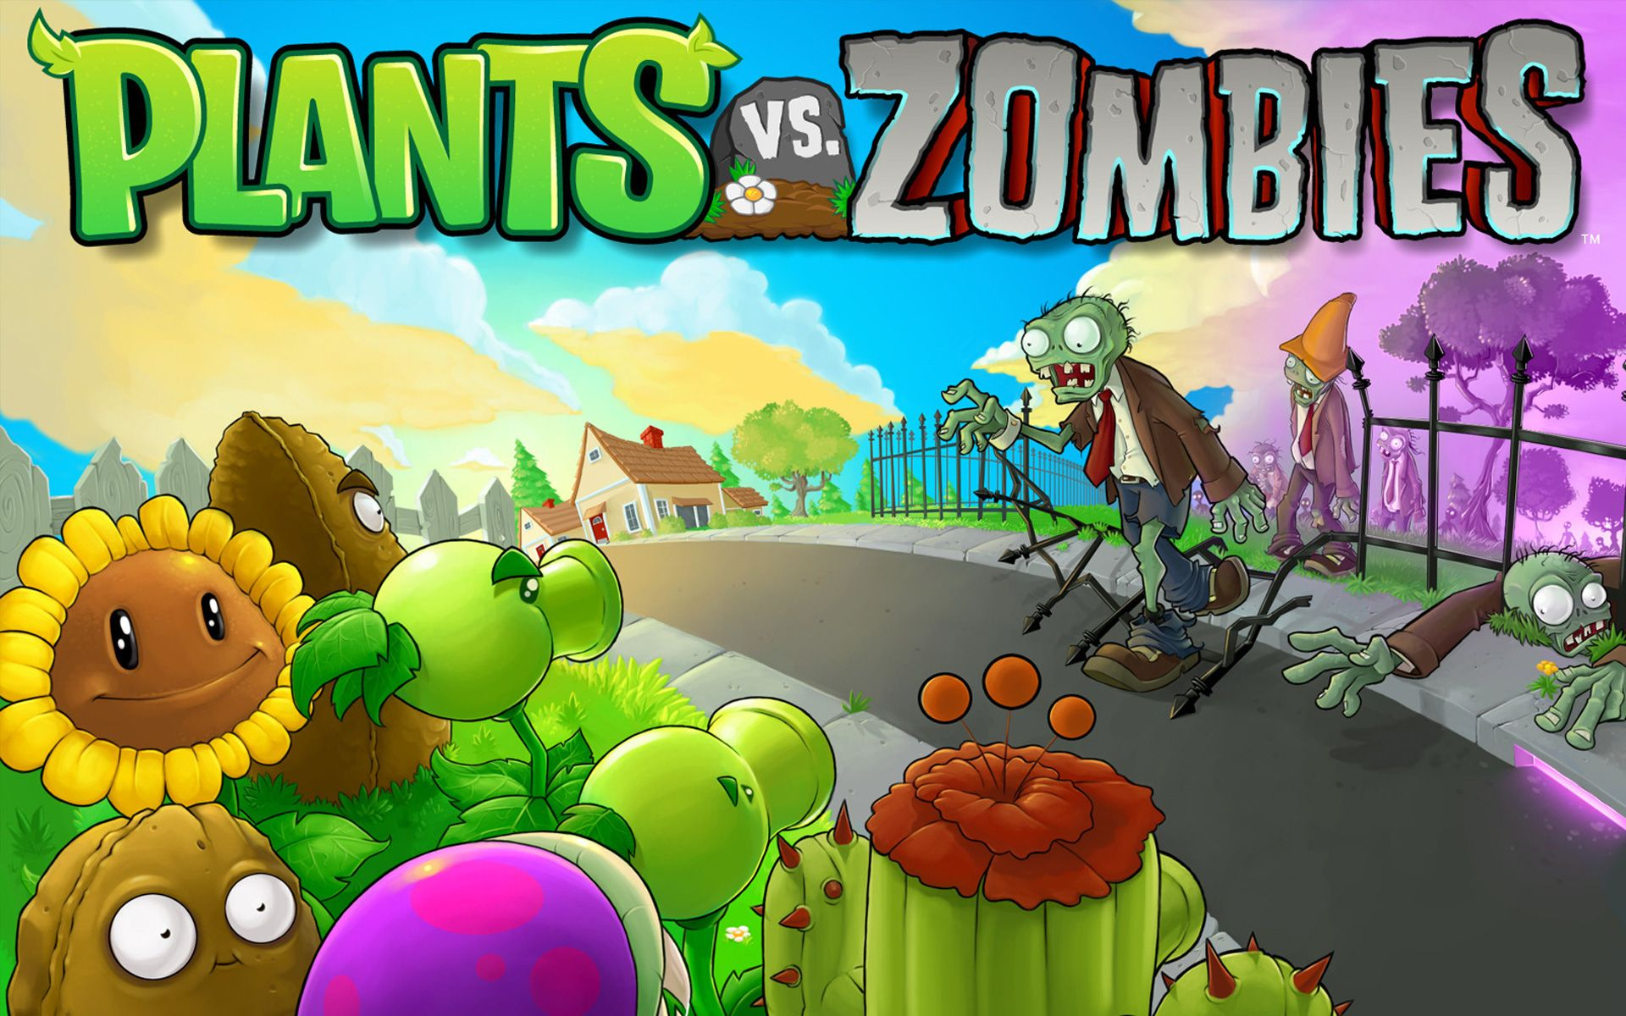


PRESENTATION PROJECT
LAB OOP GR1 – L2
--
CHICKEN TEAM
CREATED BY: CHICKEN TEAM

Slide 2

MEMBER
Nguyễn Hoàng Gia Ân
ITCSIU21161
Nguyễn Trọng Nguyên
ITITIU21236
Võ Minh Khang
ITCSIU21136
CREATED BY: CHICKEN TEAM

Slide 3
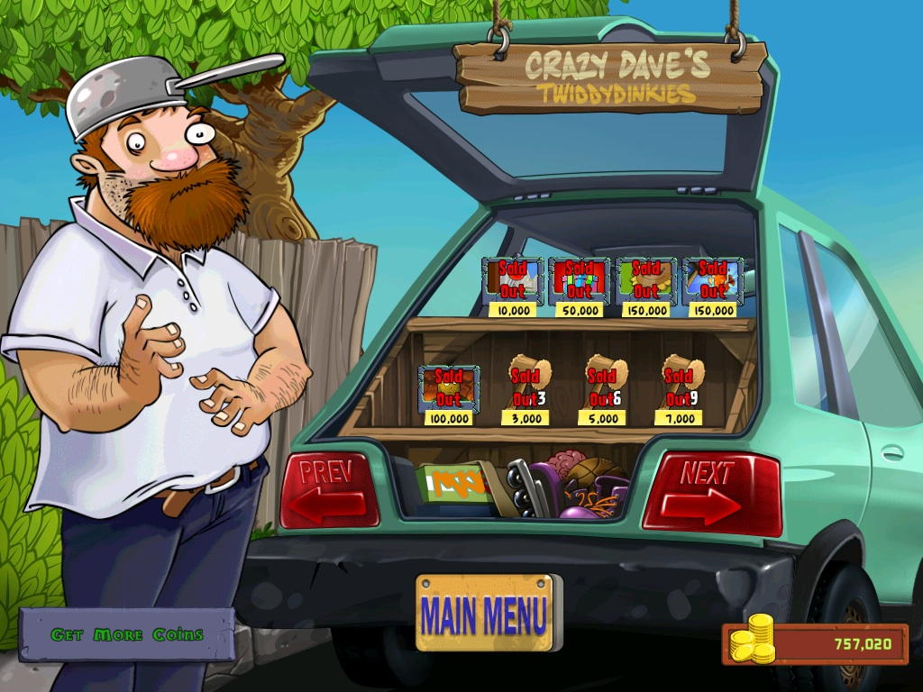
1
Introduction
2
Character & animation
3
Other feartures
CREATED BY: CHICKEN TEAM
Notes:
There is a MACRO that is set to pick RANDOM slides from 37-64

Slide 4
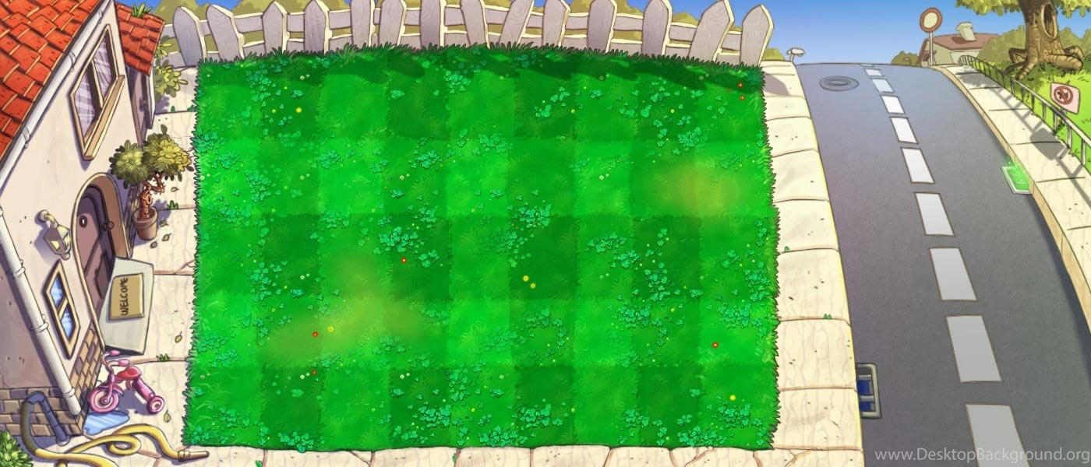

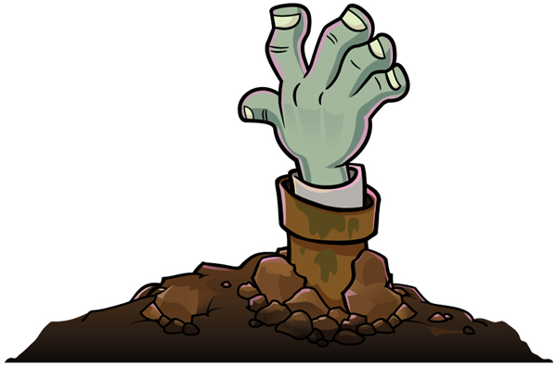
Introduction
The farmer faces a zombie epidemic that is invading his family. The farmer will join the plants with special abilities to kill the zombies.
CREATED BY: CHICKEN TEAM

Slide 5
Introduction
Game rule
The player controls the plants with special skills into the squares on the lawn to kill the zombies.
Each type of zombie will have a different amount of health
Victory: when killing all zombies of the level.
Defeat: zombies pass through the yard and enter the house
CREATED BY: CHICKEN TEAM

Slide 6
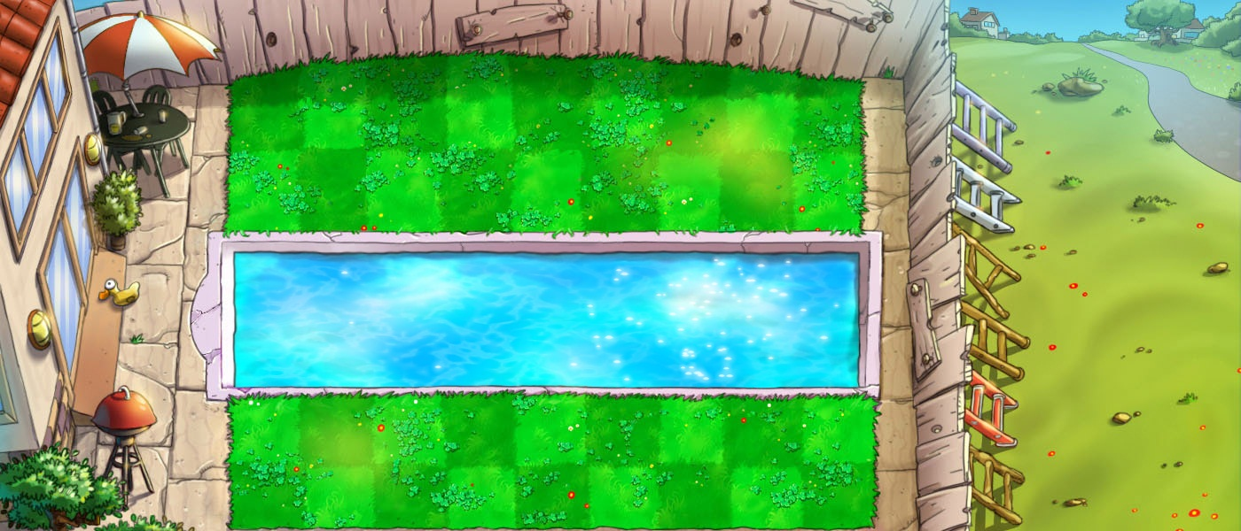
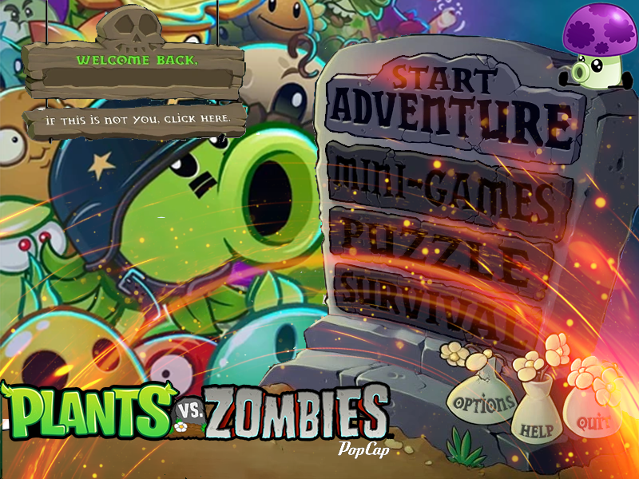
Menu screen
Start new game
Save player name
Features coming out in the future
Exit game quickly
CREATED BY: CHICKEN TEAM

Slide 7
Menu screen
Jlabel
Jtextfiel
Jlabel
Jlabel
CREATED BY: CHICKEN TEAM

Slide 8
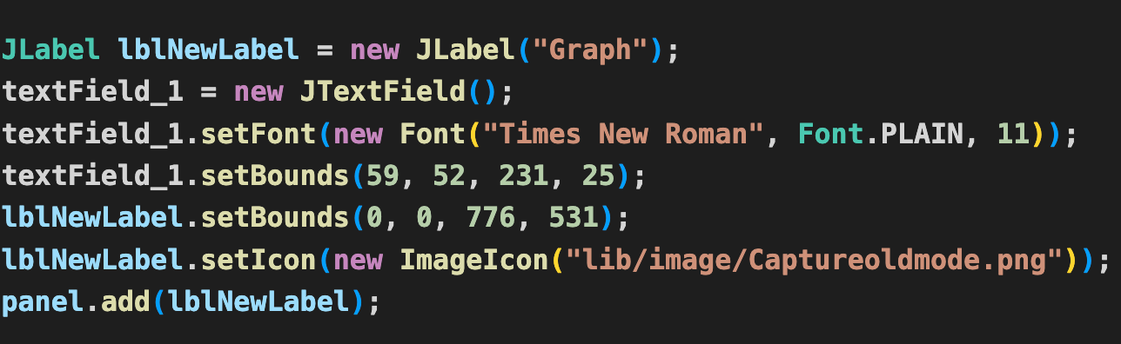
Menu screen
Code
CREATED BY: CHICKEN TEAM

Slide 9
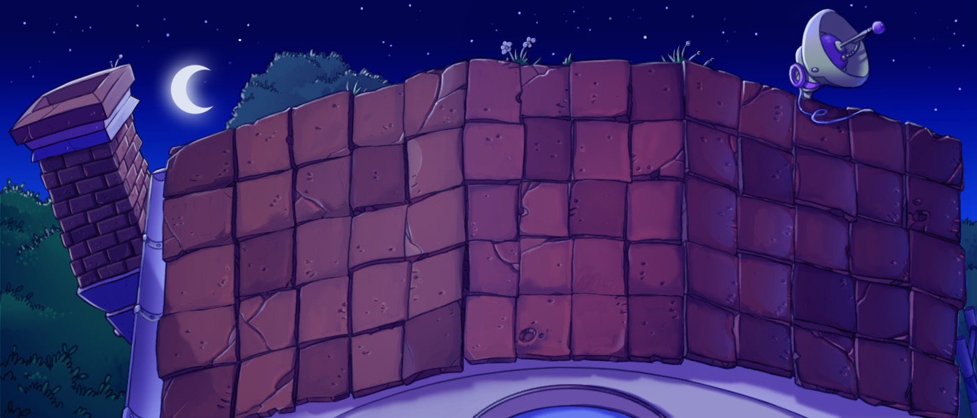
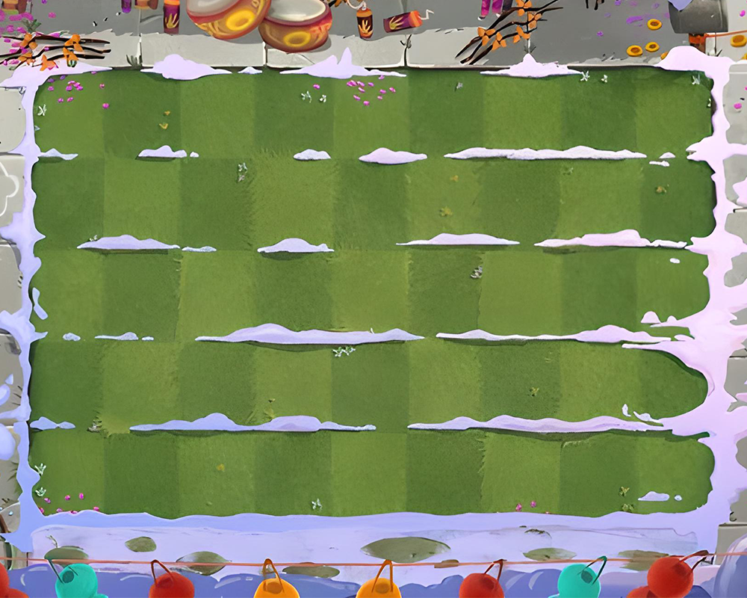
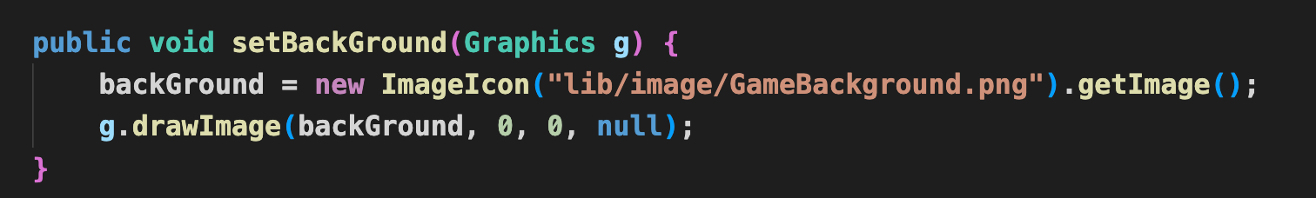
Game Background
Code
CREATED BY: CHICKEN TEAM

Slide 10
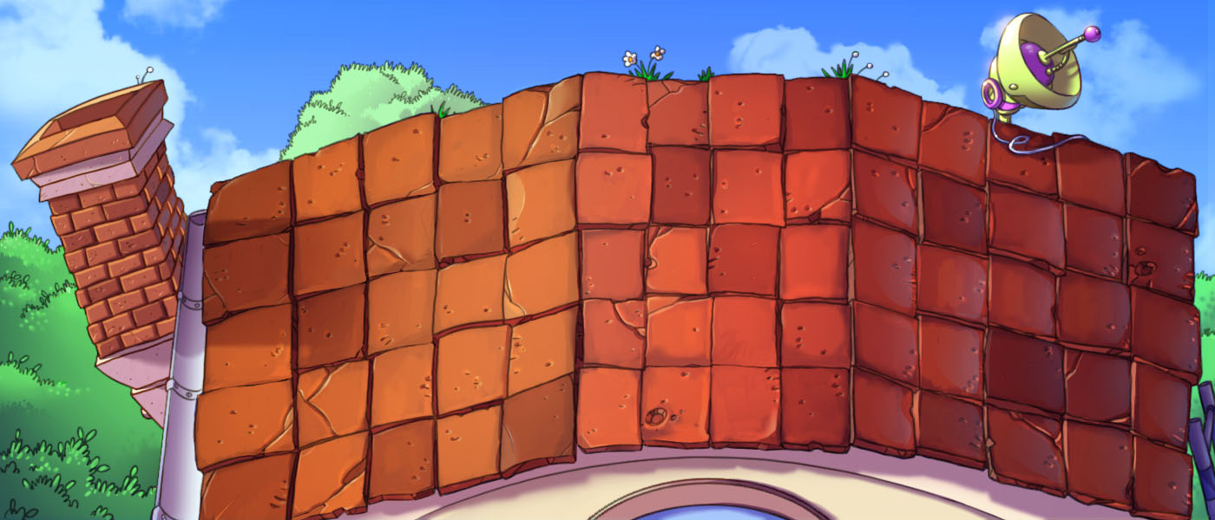


Plant
Pea Shooter
Attack on zombie: 15 HP
Cool Down: 1 second
Effect by attack: - 0.01s
CREATED BY: CHICKEN TEAM

Slide 11

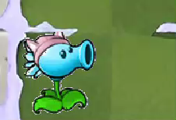
Plant
Freeze Pea
Attack on zombie: 25 HP
Cool Down: 0.5 second
Effect by attack: - 0.1s
CREATED BY: CHICKEN TEAM

Slide 12
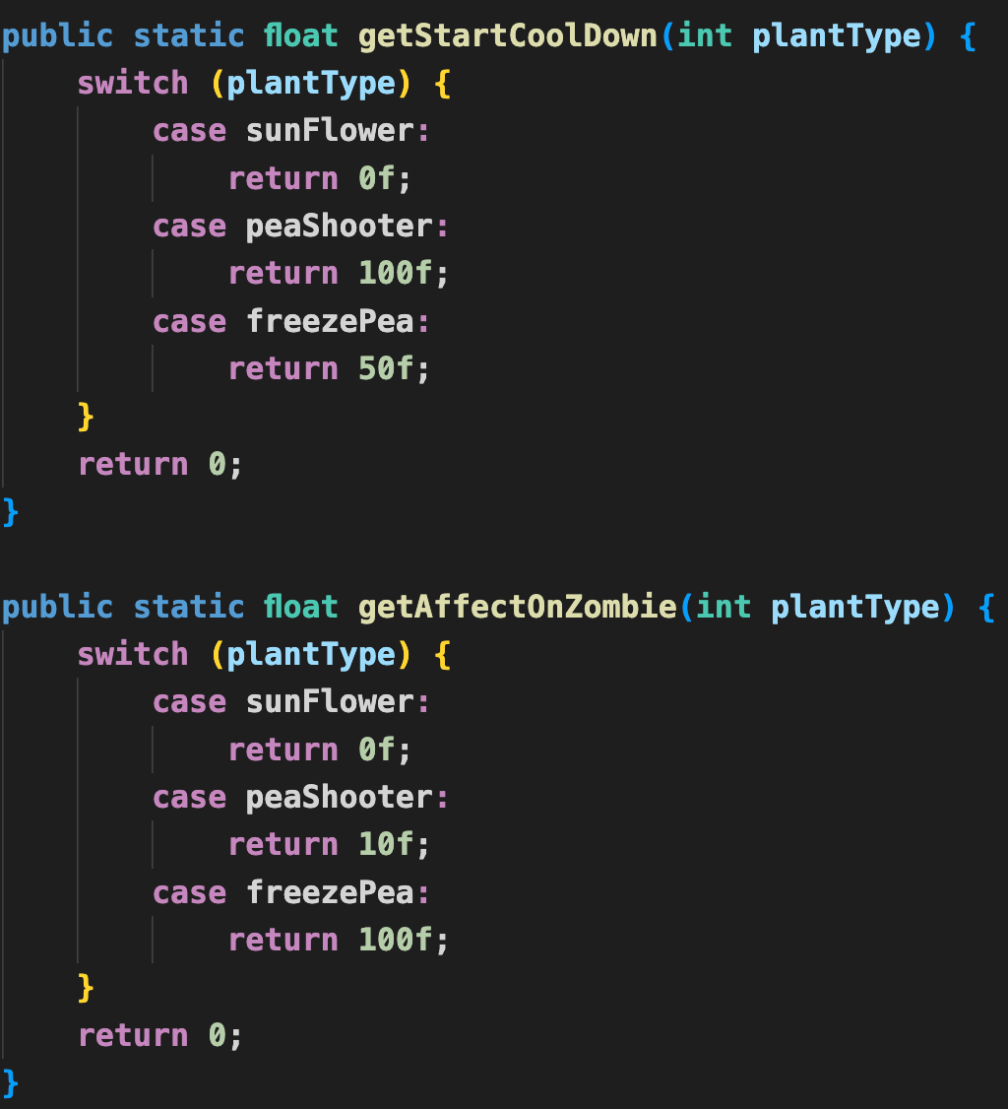

Code
Plant
CREATED BY: CHICKEN TEAM

Slide 13
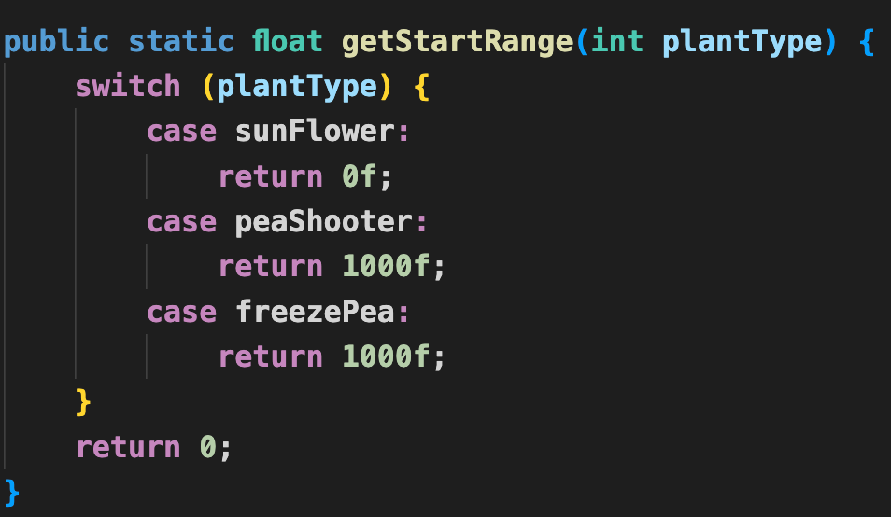
Plant
Code
CREATED BY: CHICKEN TEAM

Slide 14
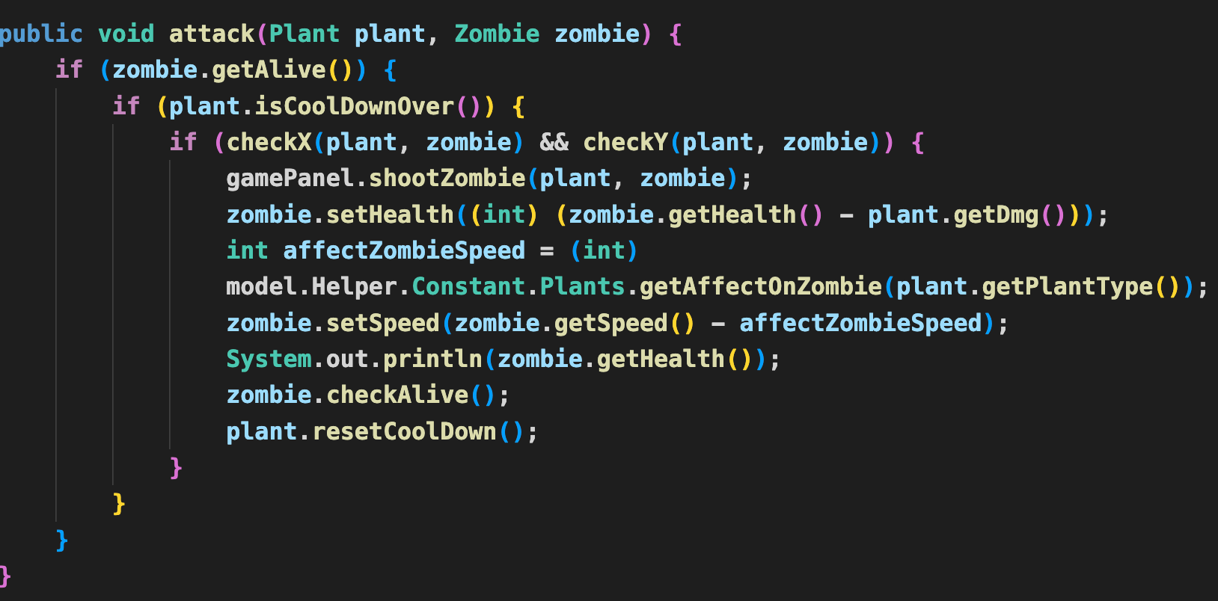
Plant
Code
CREATED BY: CHICKEN TEAM

Slide 15


Zombie
Zombie
Normal zombie
Cone zombie
Health: 150 HP
Speed: 4
Health: 250 HP
Speed: 3
CREATED BY: CHICKEN TEAM

Slide 16

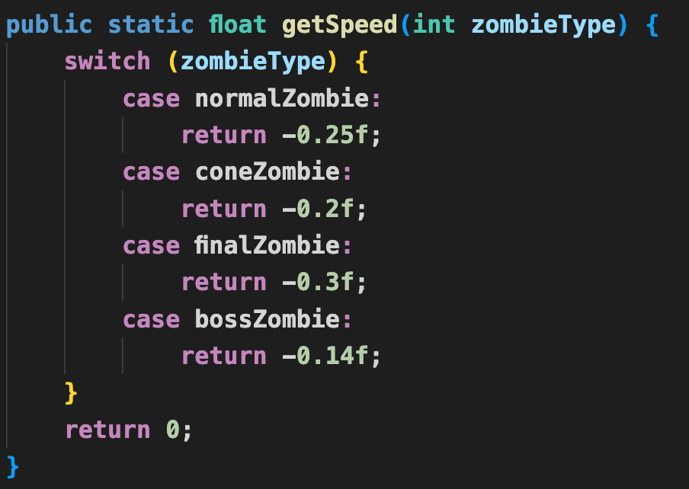
Zombie
Code
Boss zombie
Health: 300 HP
Speed: 2
CREATED BY: CHICKEN TEAM

Slide 17
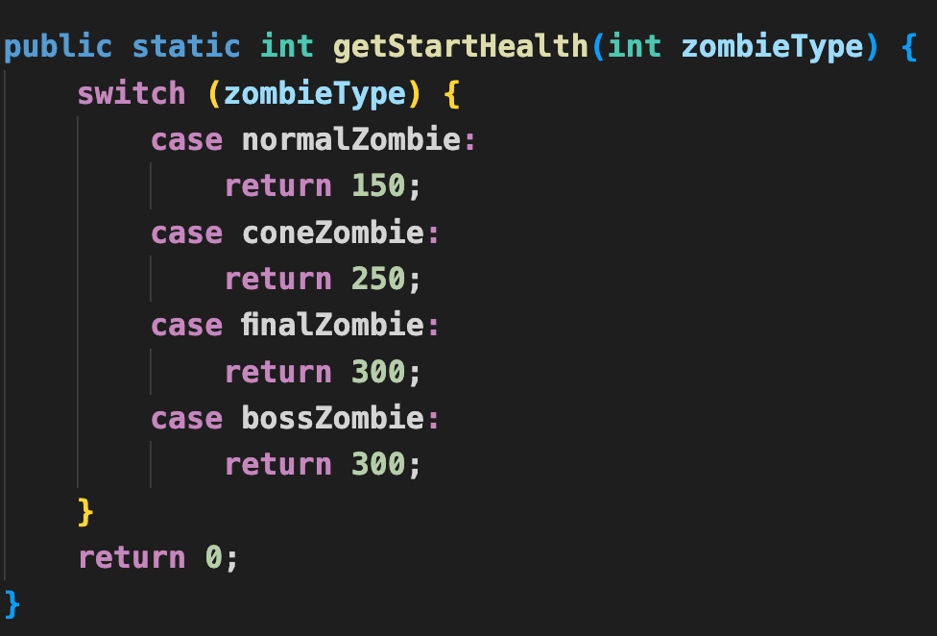
Zombie
Code
CREATED BY: CHICKEN TEAM

Slide 18
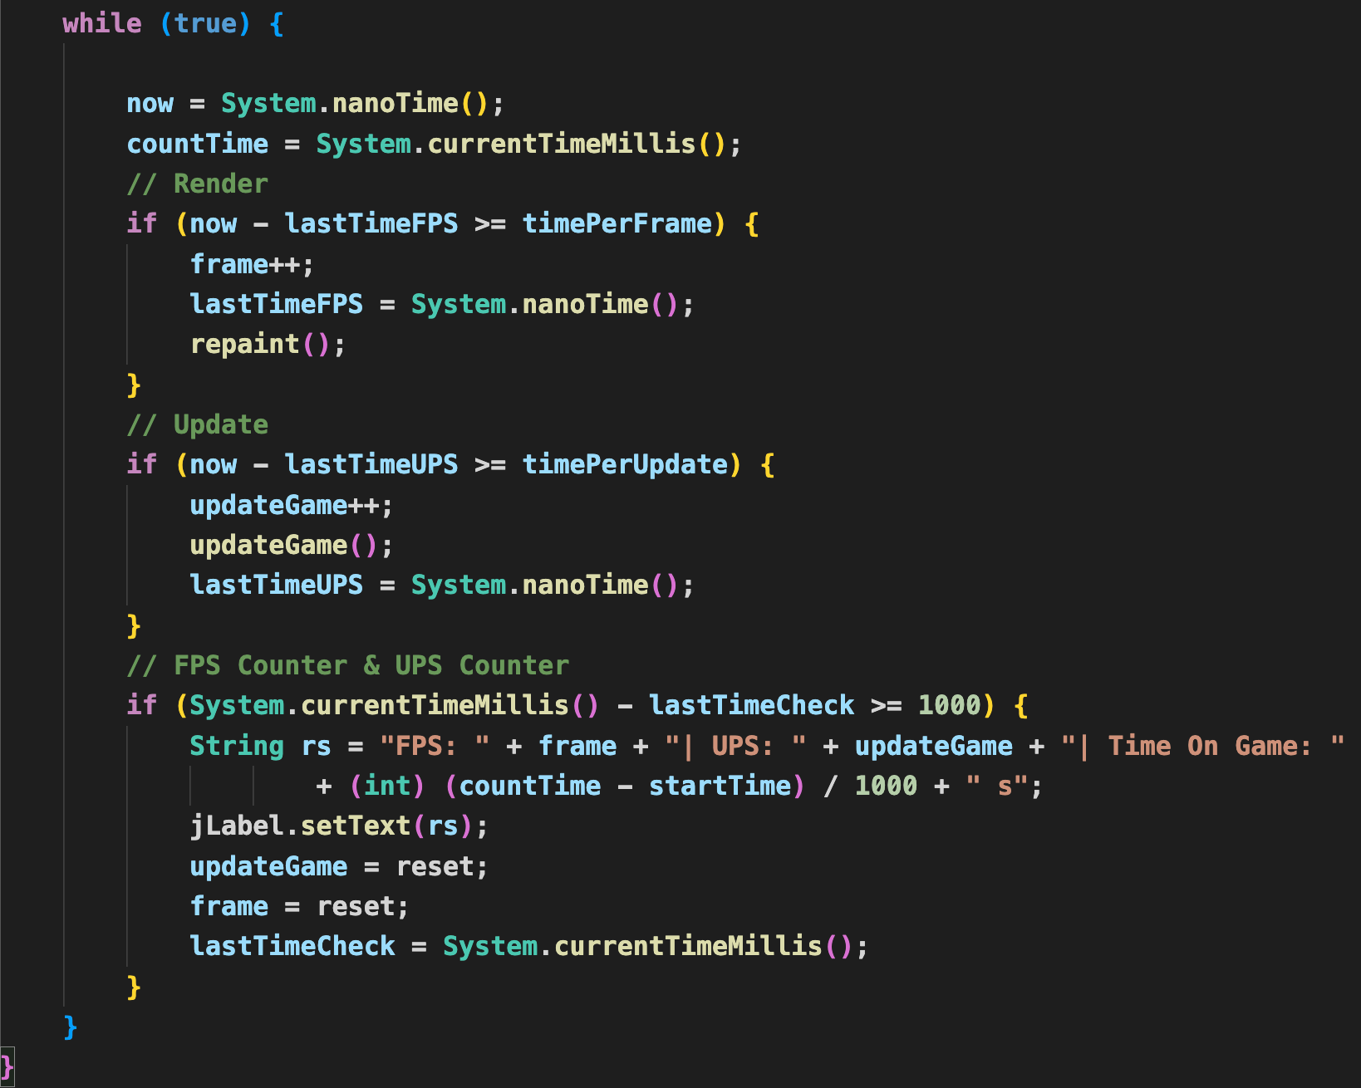
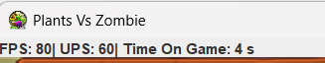
Code
Other features
FPS counter
UPS counter
Show the value of FPS UPS and playing time
CREATED BY: CHICKEN TEAM

Slide 19
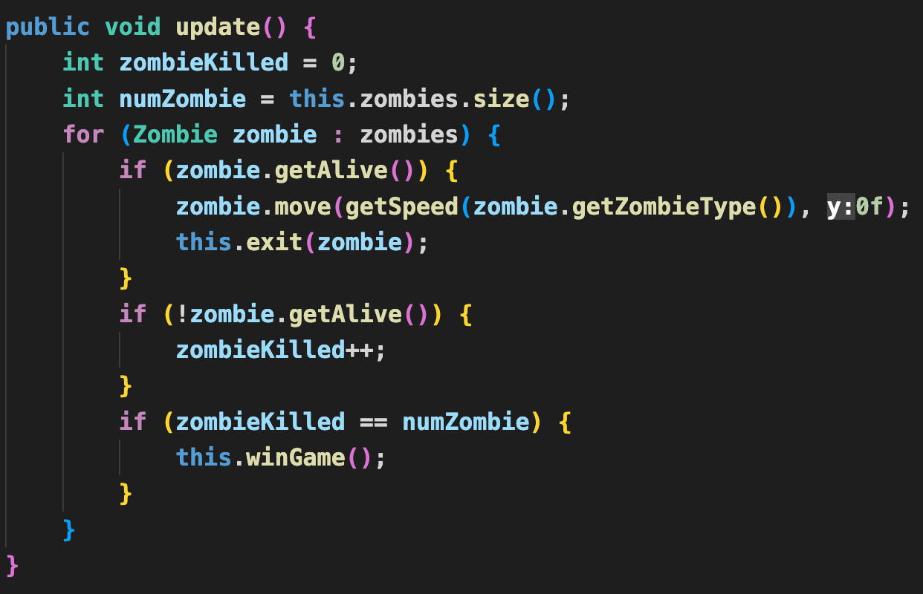

Code
Other features
Effect and rules to end the game when killing all zombies
CREATED BY: CHICKEN TEAM

Slide 20
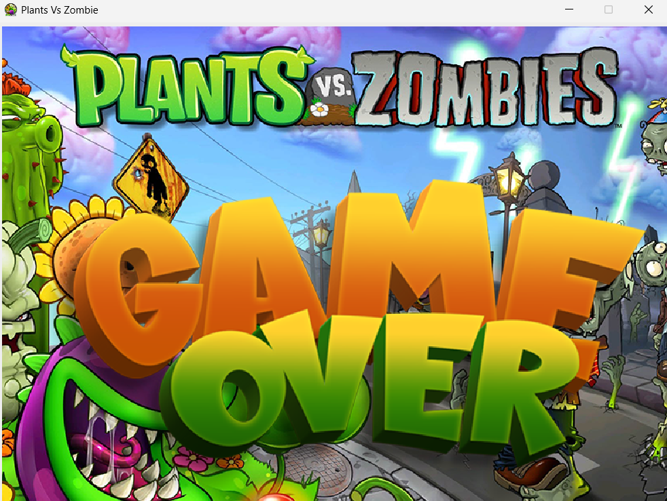
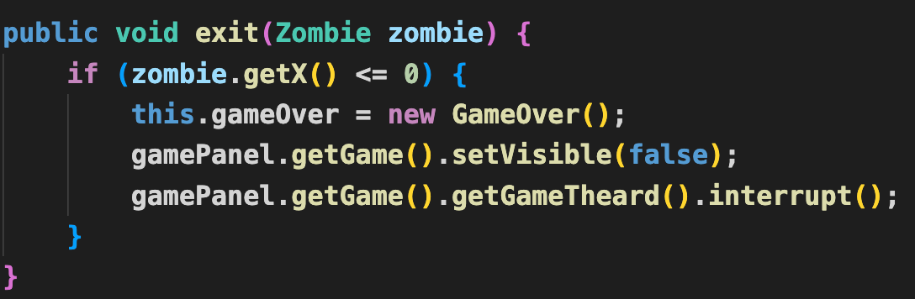
Other features
Code
Effect and rules to end the game when zombies enter the house
CREATED BY: CHICKEN TEAM

Slide 21

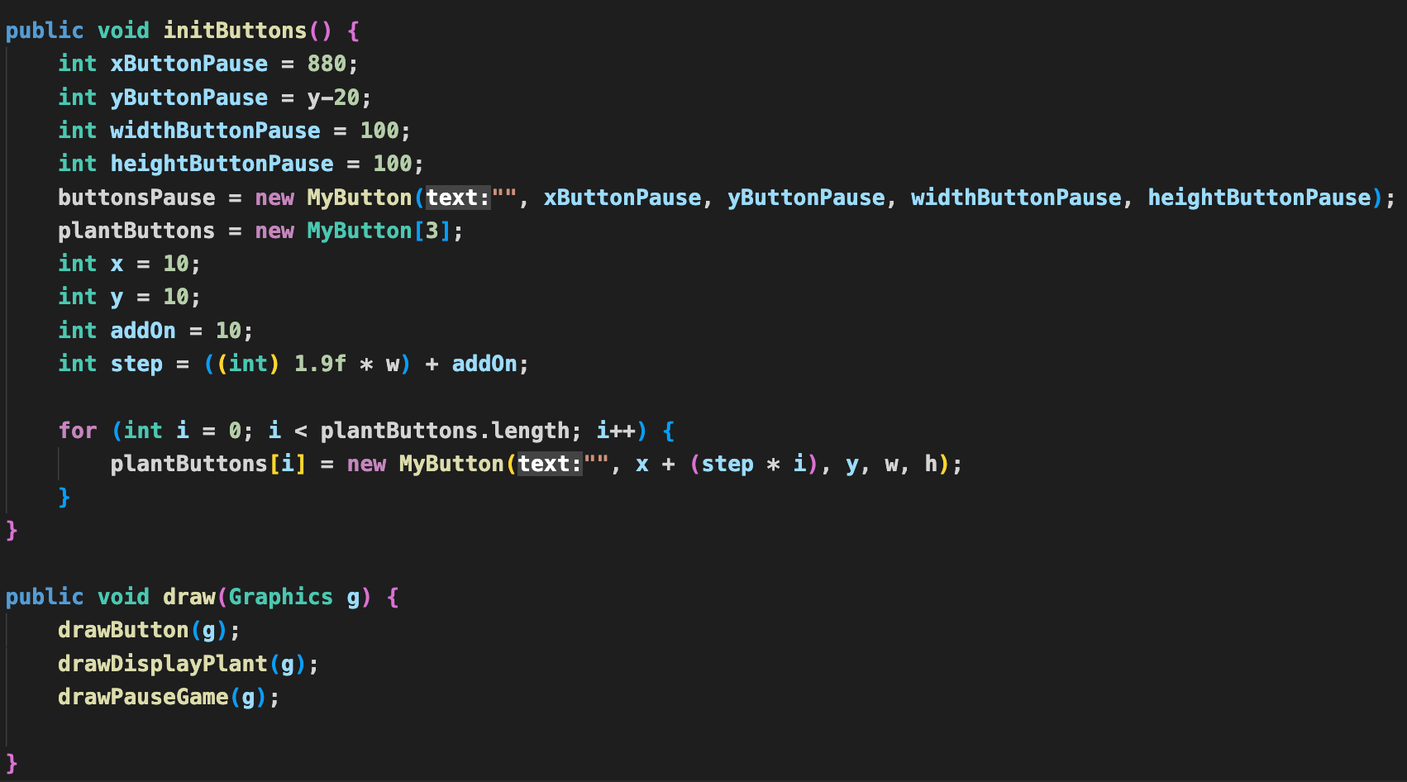

Other features
Code
Pause game button
CREATED BY: CHICKEN TEAM

Slide 22
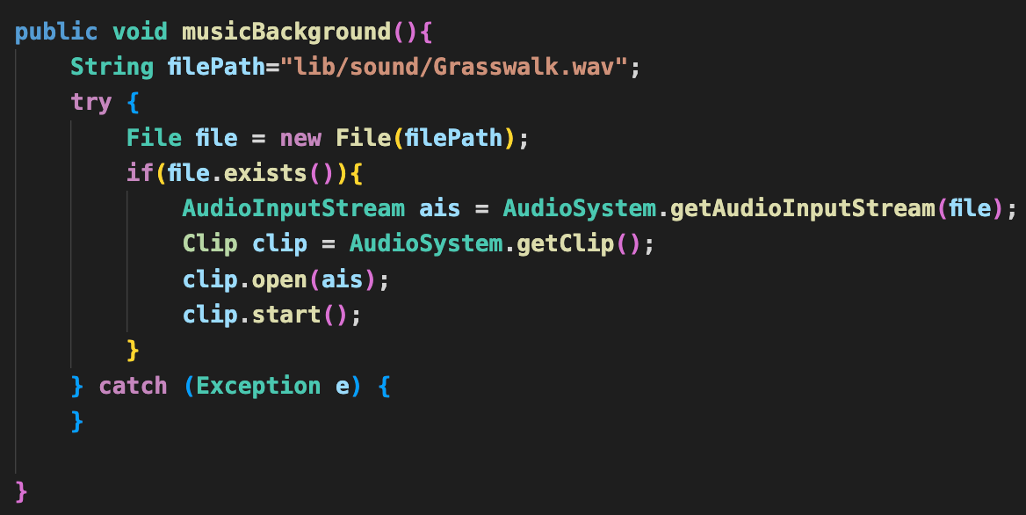

Other features
Code
Background Music
CREATED BY: CHICKEN TEAM

Slide 23
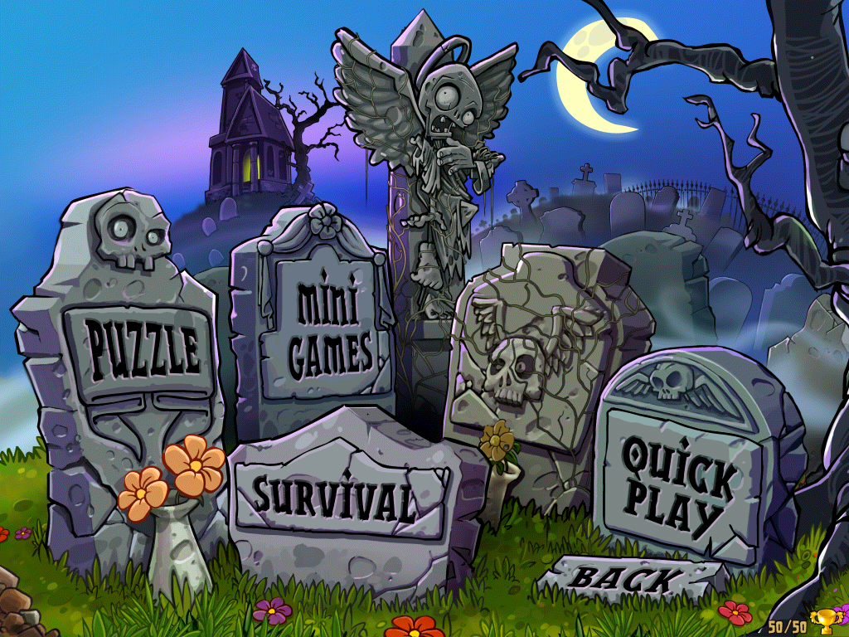
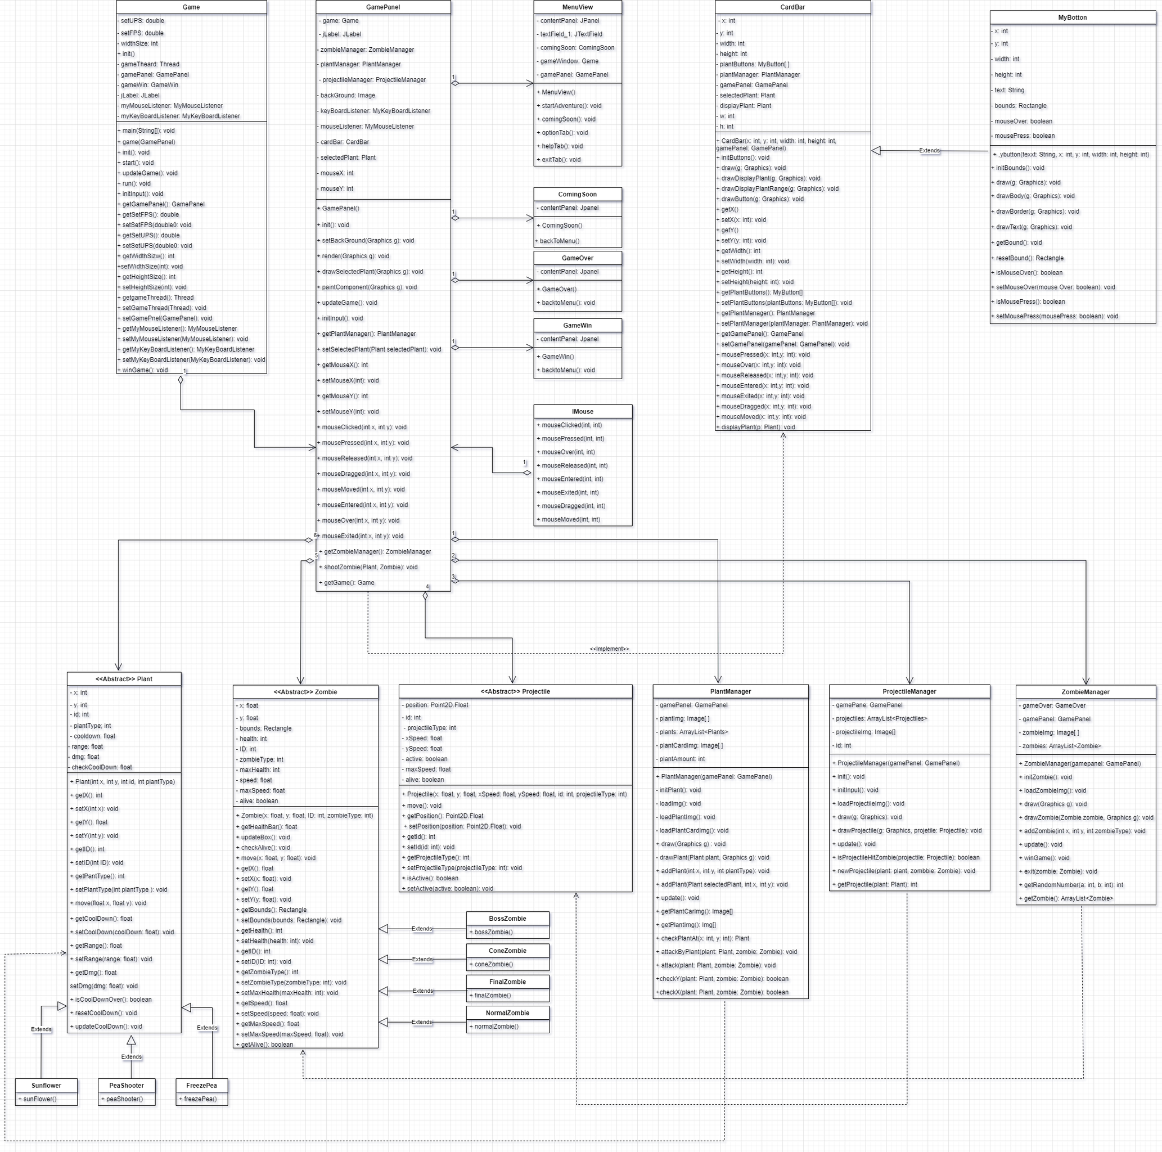
UML DIAGRAM
CREATED BY: CHICKEN TEAM
Notes:
Edit the question.
Edit the answer (O) = Correct (X) = Wrong
Right click change picture to replace your own picture
Correct answer will take you to a menu page for you to choose a (plant) or (zombie).
Wrong answer a zombie will appear. Click the zombie hand to go back to the main menu.

Slide 24
THANK YOU FOR
YOUR ATTENTION
CREATED BY: CHICKEN TEAM

